Slide 1

Programming
Notes:
Most of human history has been someone telling someone else what to do.

Slide 2
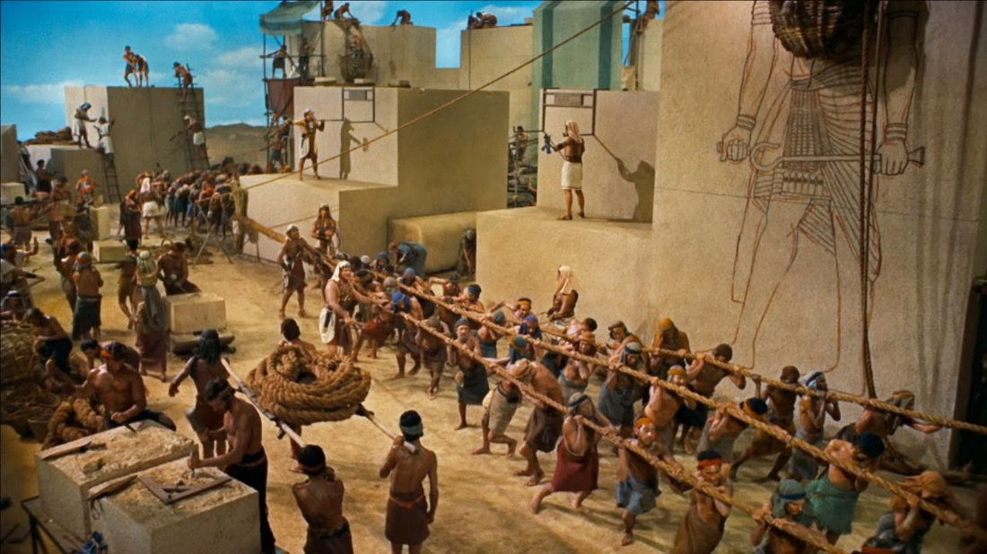
Notes:
Building pyramids

Slide 3
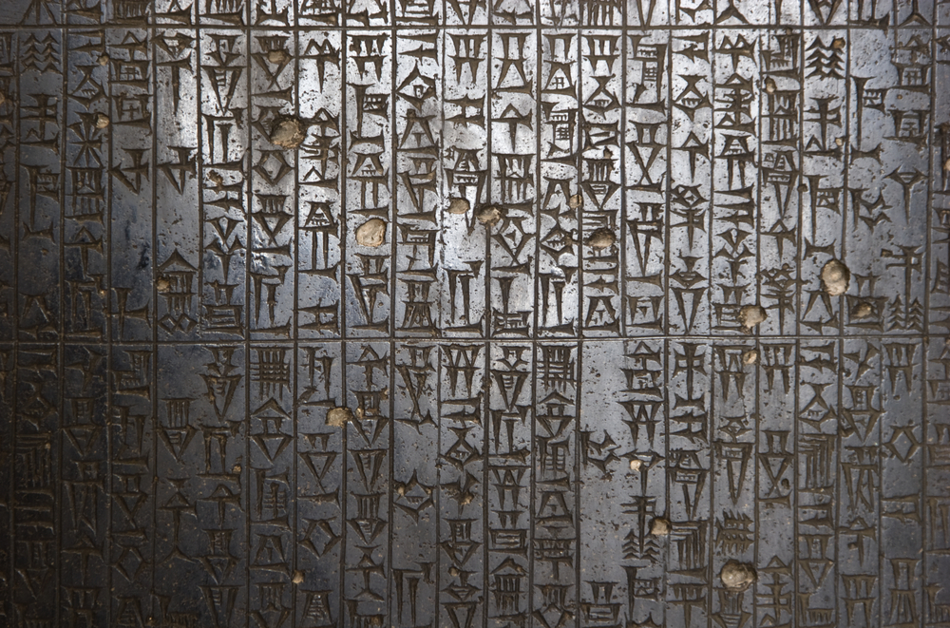
Notes:
Code of Hammarabi

Slide 4
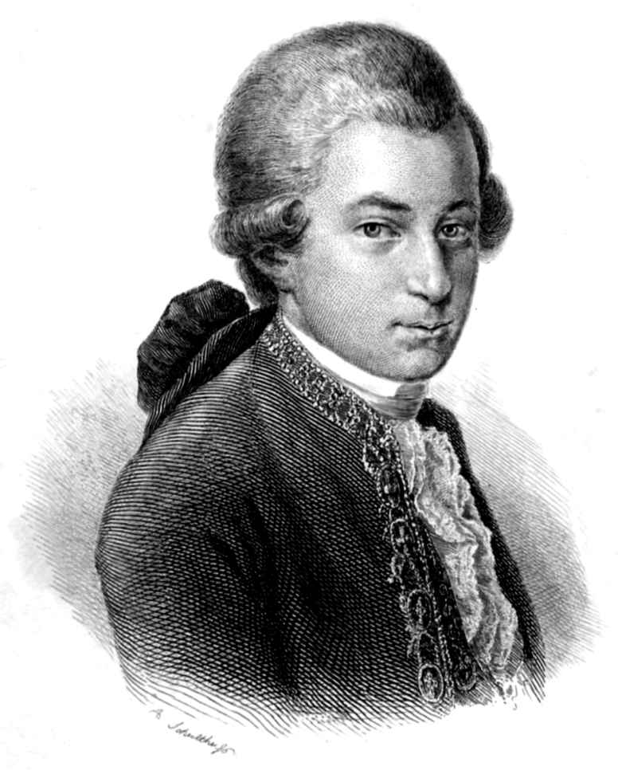
Notes:
Mozart the dead composer wrote his programs in standard music notation. Thats really what music is, a written set of instructions for a human and a machine to carry out together. Human plays violin, piano etc. and even though Mozart is now dead, we can
still enjoy his music provided the musicians are able to carry out his instructions to the letter (with some interpretation). No one needs the ghost of the composer to be present to make sure that the “code" runs.
Used sets of instructions to ensure the vision he had in his head was able to be reproduced without him having to be there to supervise every minute.

Slide 5
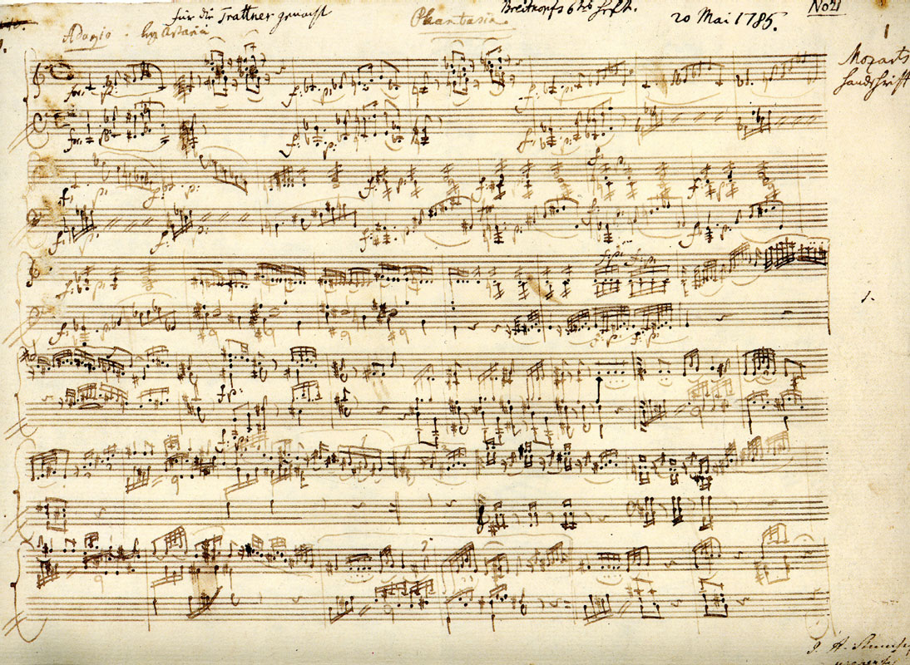
Notes:
We call these instructions music notation.
Human and violin together is the machine, manuscript is the input, sound is the output.

Slide 6
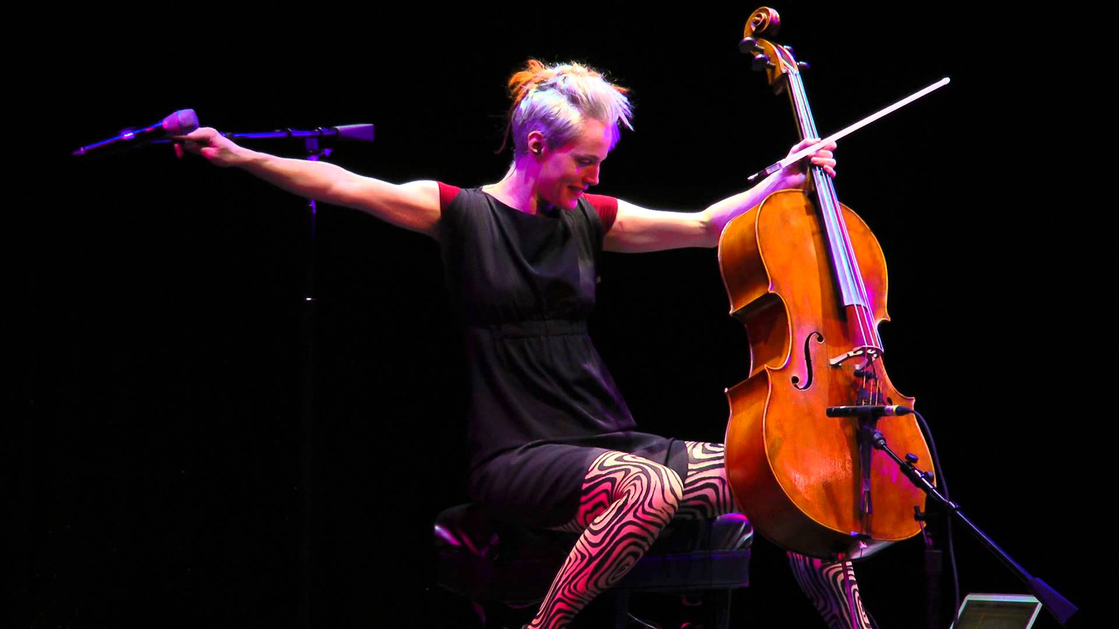
Notes:
We looked at programming music - standard notation and using sonic pi - Zoe Keating

Slide 7
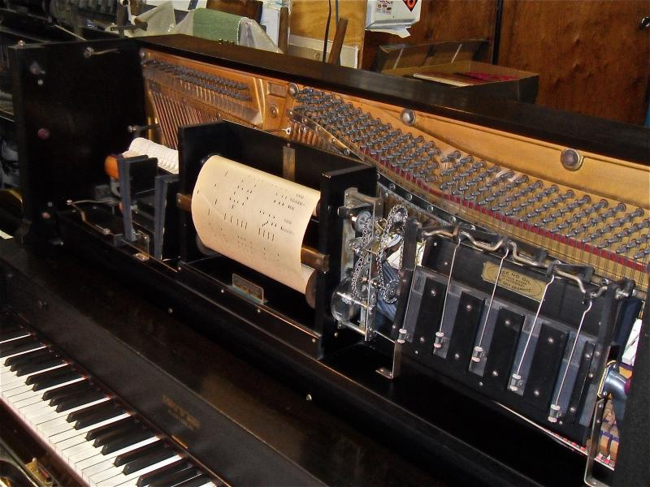
Notes:
Mozarts performances don’t require him

Slide 8
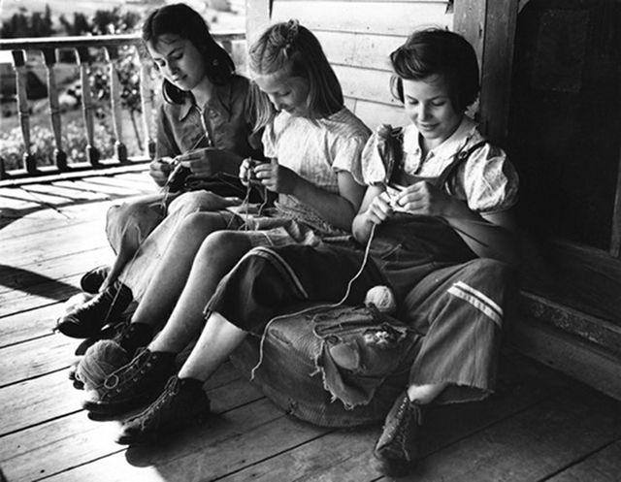
Notes:
Knitting is a form of programming, passed down usually from parent or grandparent to child. Repetition of simple steps, maybe with some variation, can give lots of beauty and complexity.

Slide 9
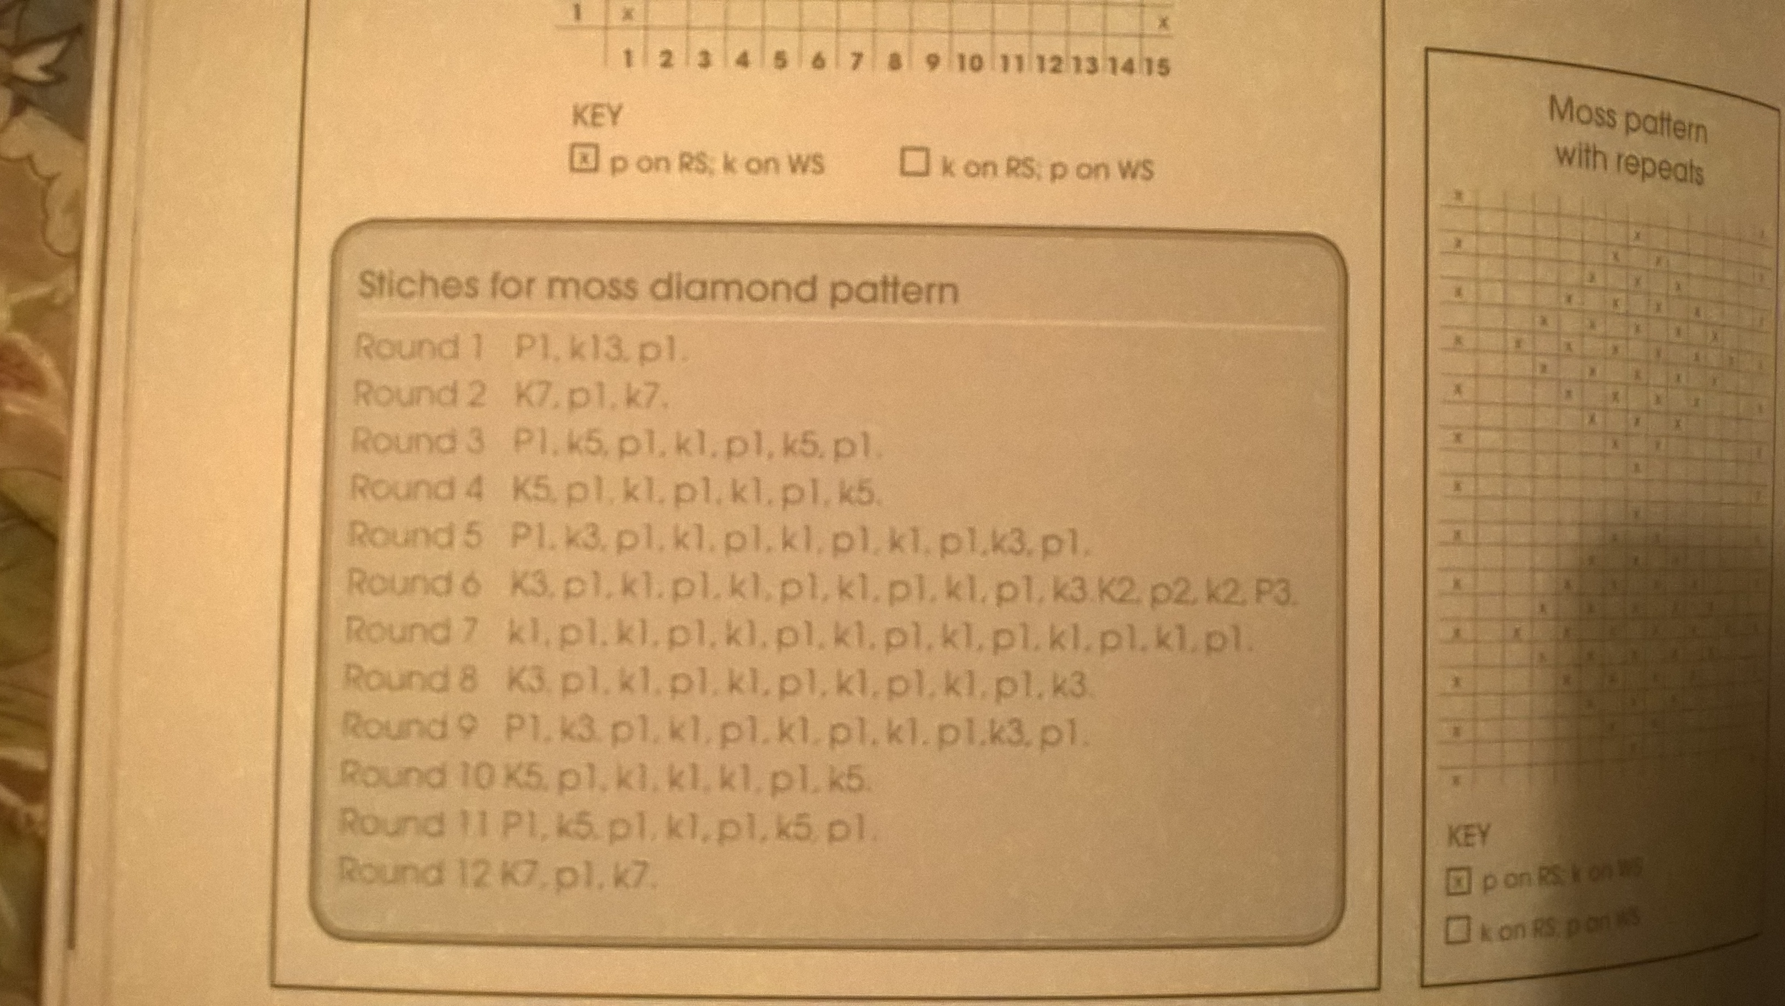

Slide 10
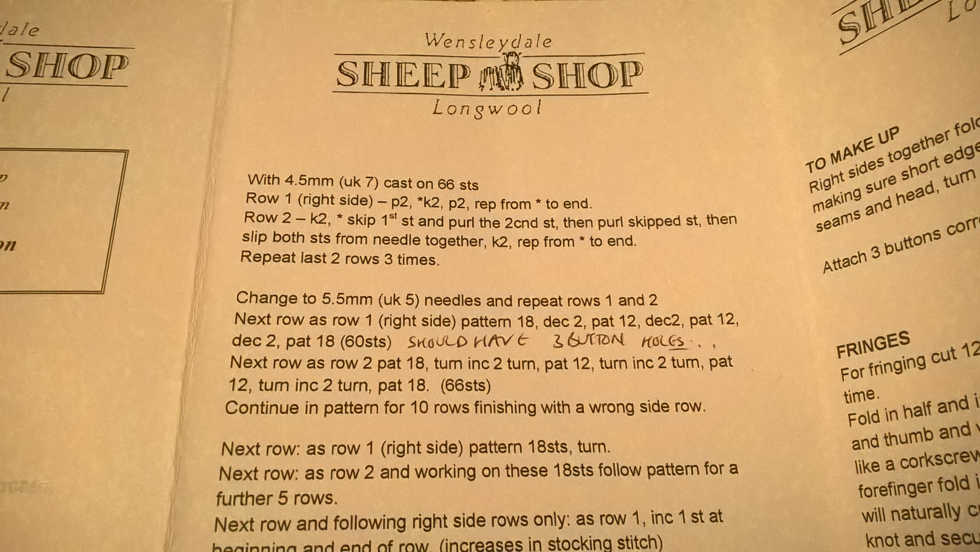

Slide 11
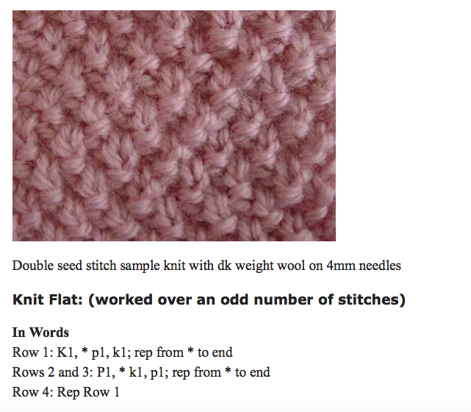
Notes:
small number of instructions, repeated and permuted to form useful and beautiful things.

Slide 12
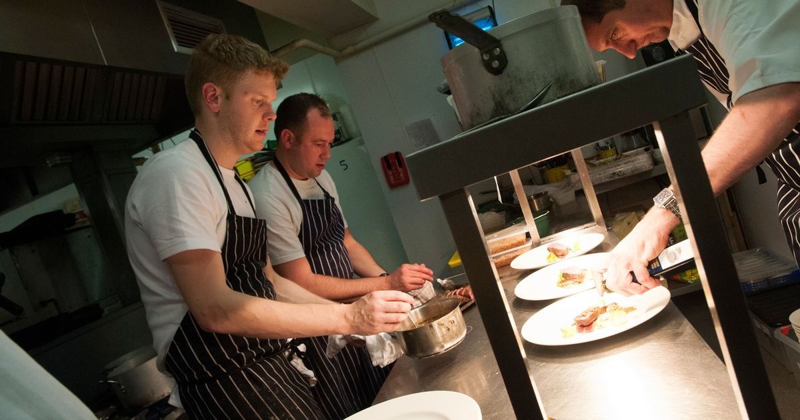
Notes:
recipes are a way of encoding creative knowledge for someone to reproduce the similar results to a top chef. John Calton.

Slide 13
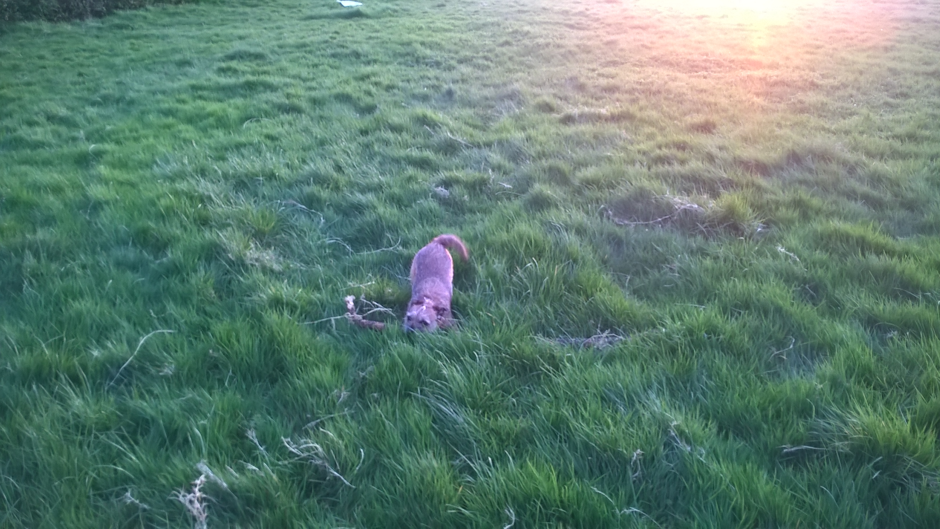

Slide 14
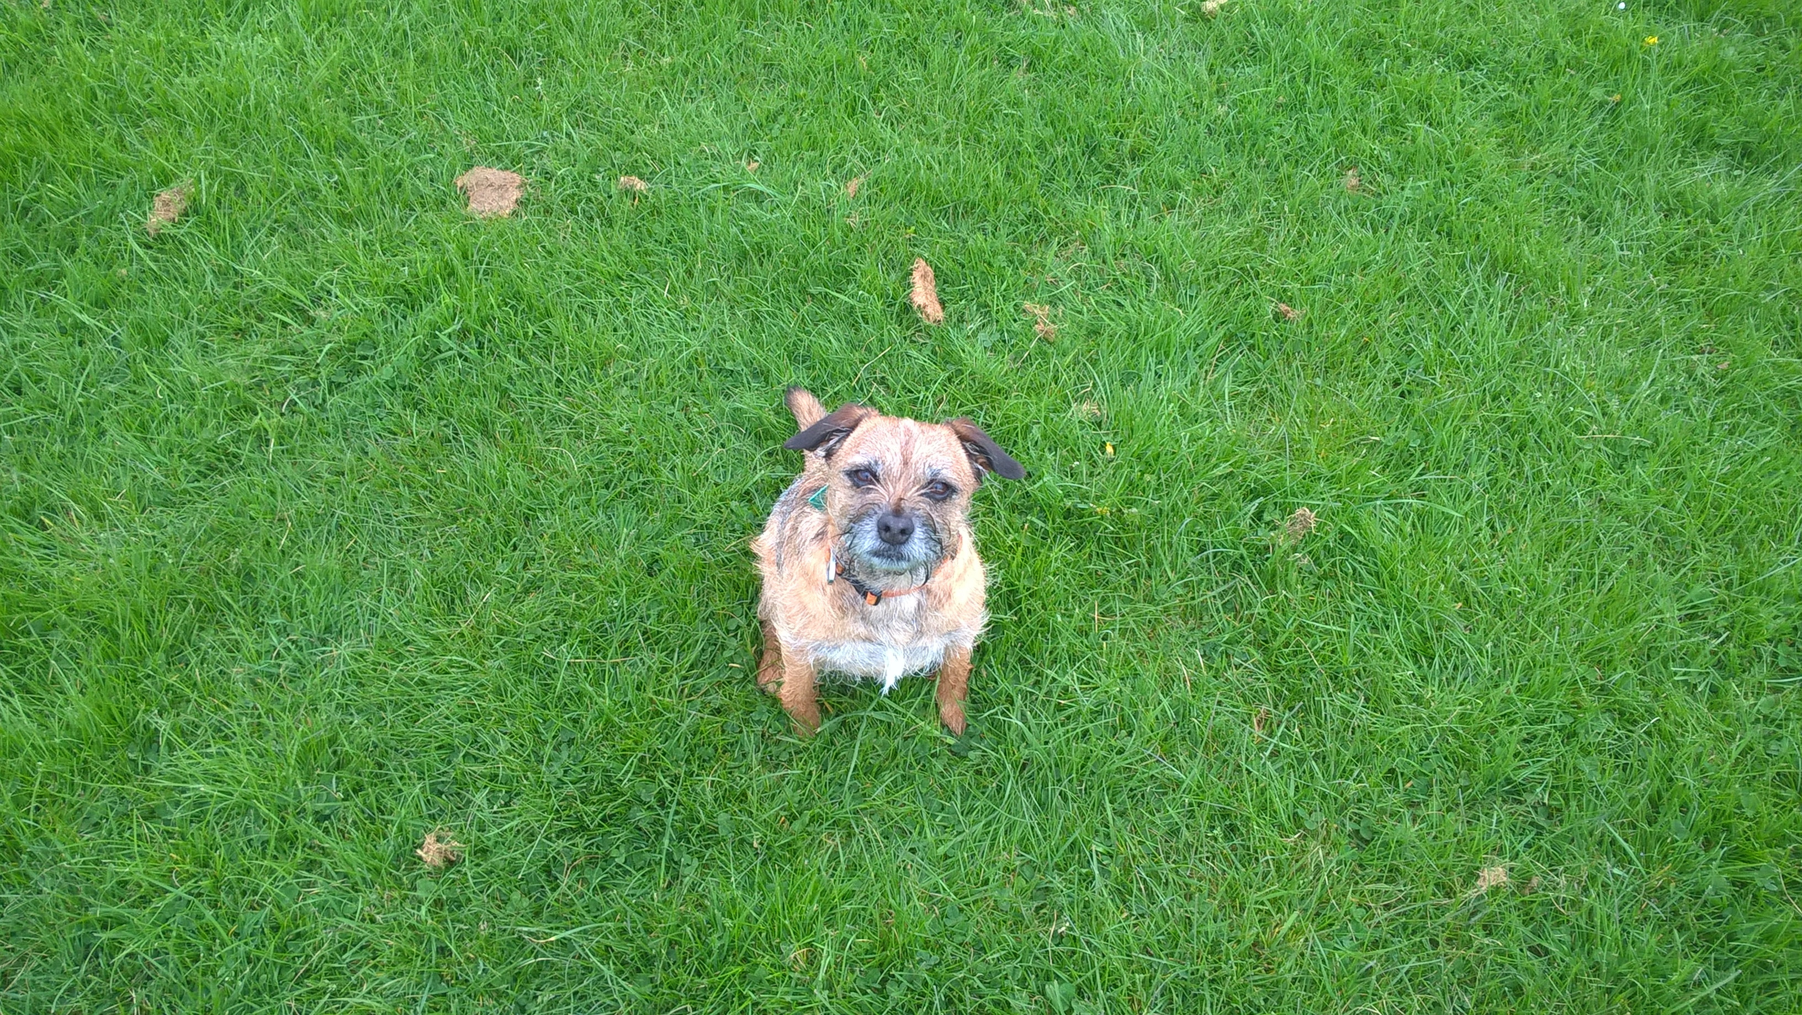

Slide 15
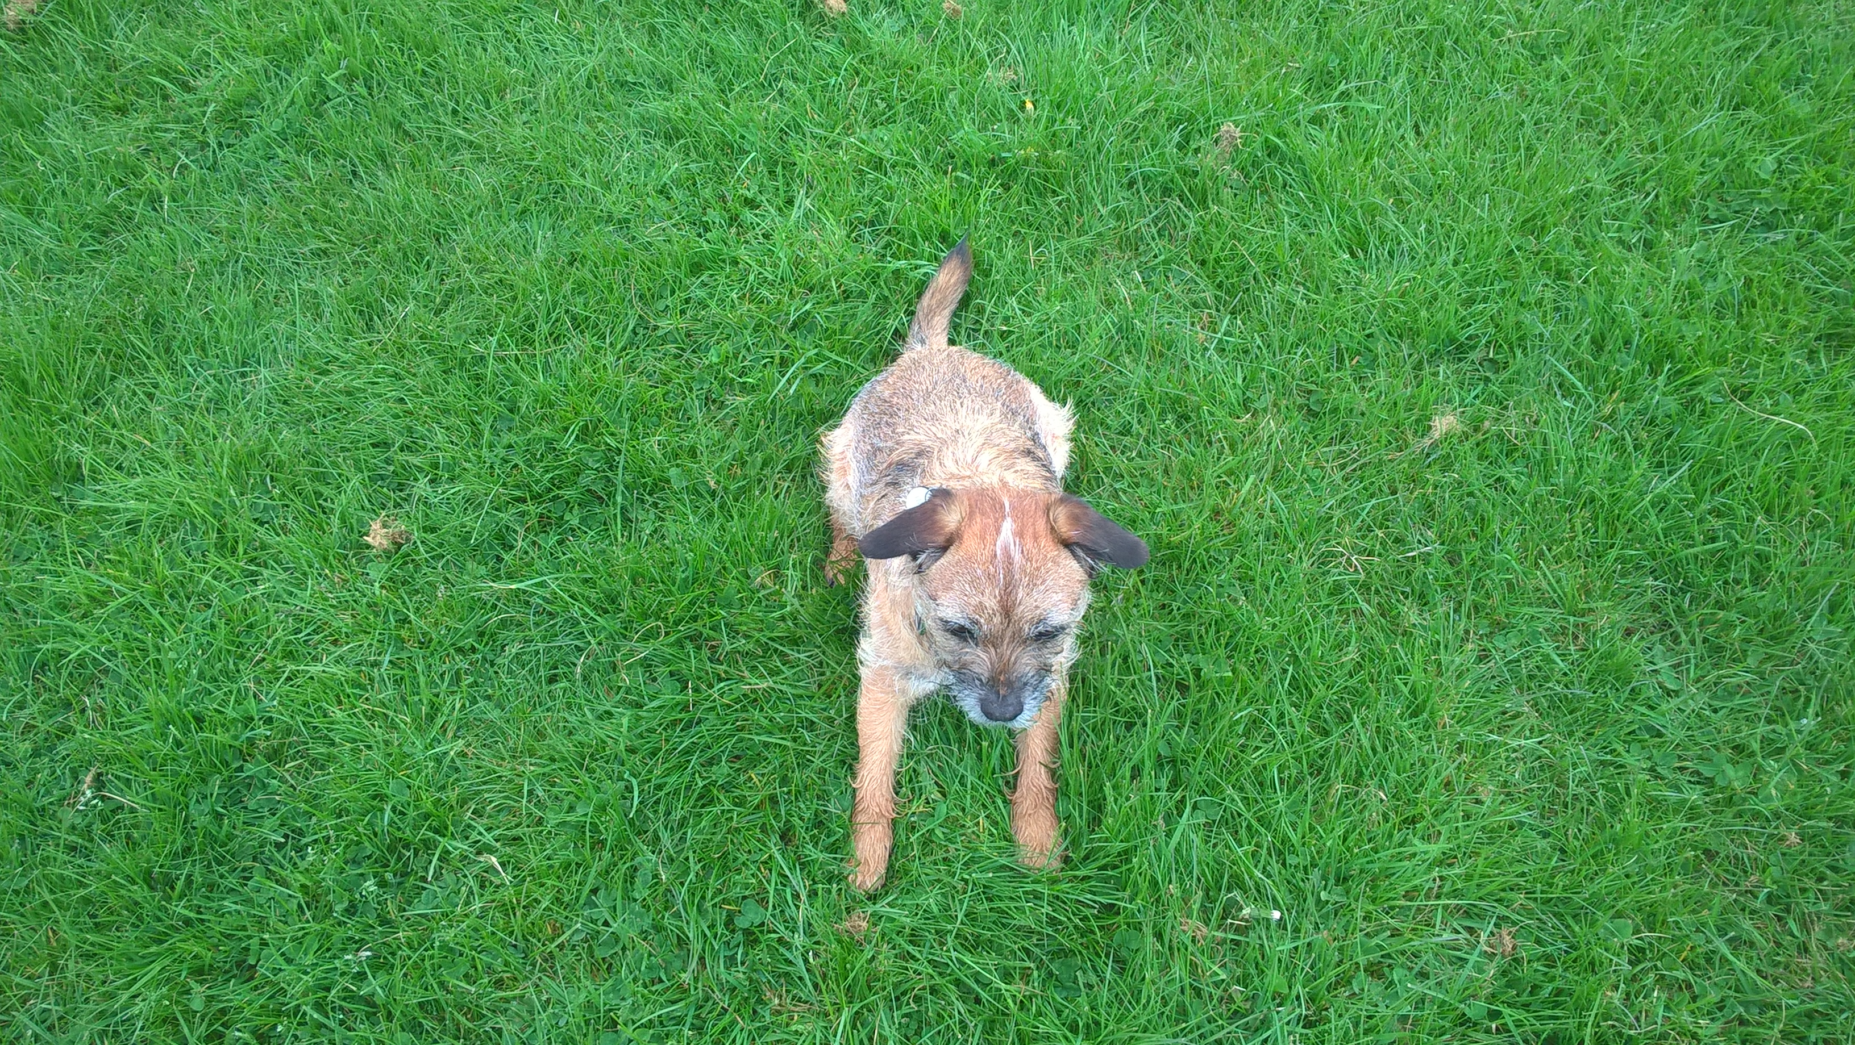

Slide 16
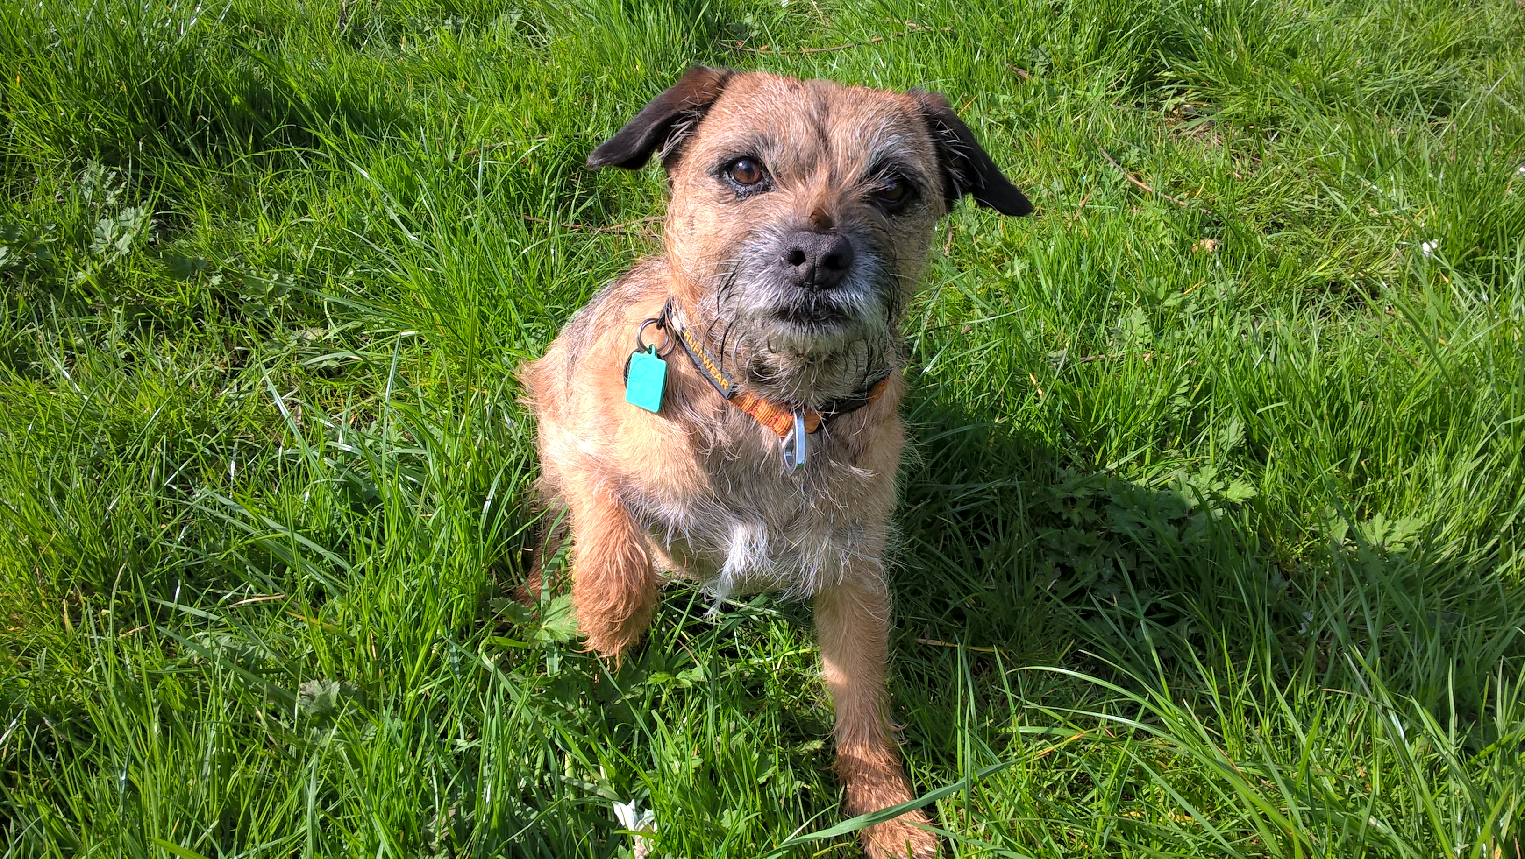

Slide 17
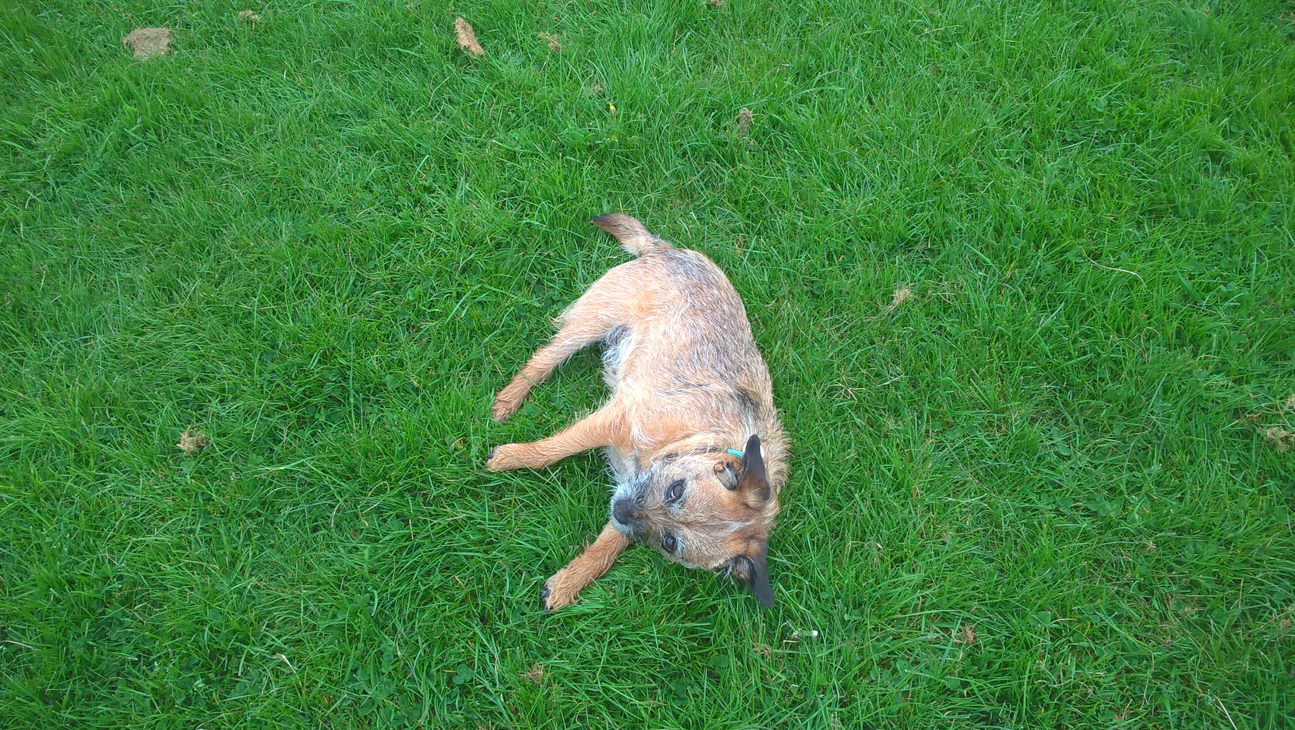

Slide 18
So…

Slide 19
Turns out…
we don’t always need a computer
computers are good at repeating
they aren’t good at original thought
they extend what you are capable of
Notes:
We can practice without the computer - acting all Pharao using humans or using pencil and paper, or just our own imaginations.

Slide 20
“Computer science is no more about computers than astronomy is about telescopes."
– Edsger Dijkstra

Slide 21
“Computers are good at following instructions, but not good at reading your mind”
Donald Knuth

Slide 22

Notes:
Knight capital upgraded share trading software. Turned it on Monday, lost billions, some recovered. losing USD 460m in 45 minutes.

Slide 23
Speed is no substitute for correctness
Notes:
computer will give you speed, won’t give you correct.

Slide 24
“If it doesn’t work, it doesn’t matter how fast it doesn’t work.”
- Mich Ravera
Notes:
computer will give you speed, won’t give you correct.

Slide 25
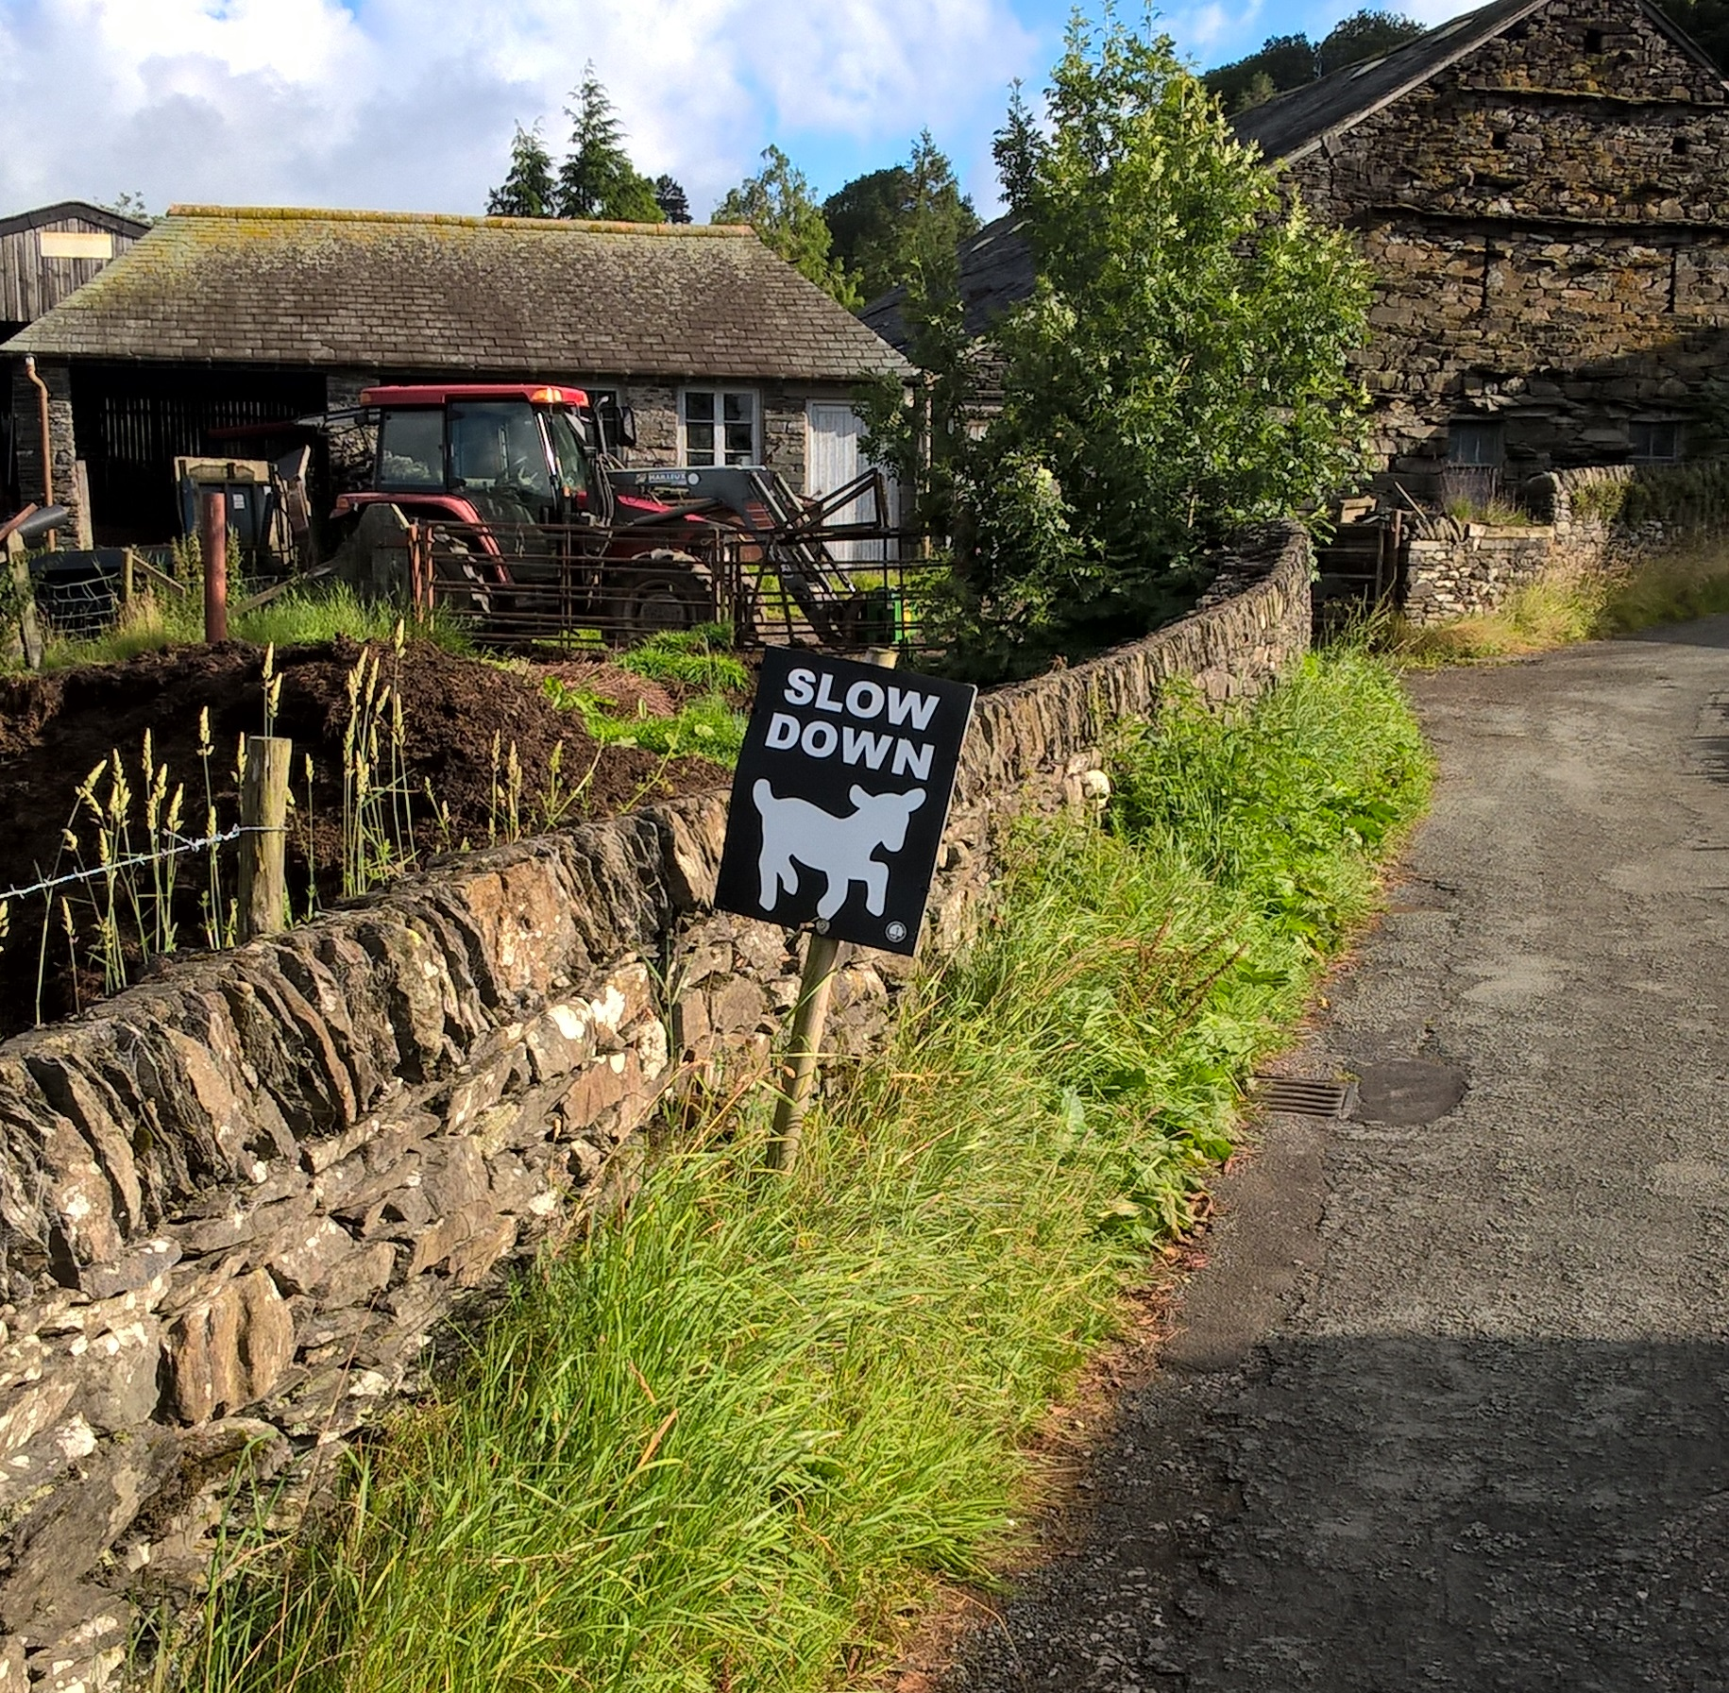
Beware
Notes:
we should be slowing down.

Slide 26
A computer program must pass through your head and fingers before it gets to the computer
Notes:
most of the activity is going on in your head. The program comes as a result of your thinking, not something inherent in the machine itself.

Slide 27
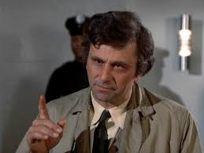
Notes:
we use a lot of clues from body and vocal inflections that a computer misses or has a hard time with Human Language, not just English, is too nuanced for computers to interpret correctly as a conversation between two intelligences.

Slide 28
Time Flies like an Arrow

Slide 29
Time Flies like an Arrow

Slide 30
Fruit Flies like a Banana

Slide 31
Fruit Flies like a Banana

Slide 32
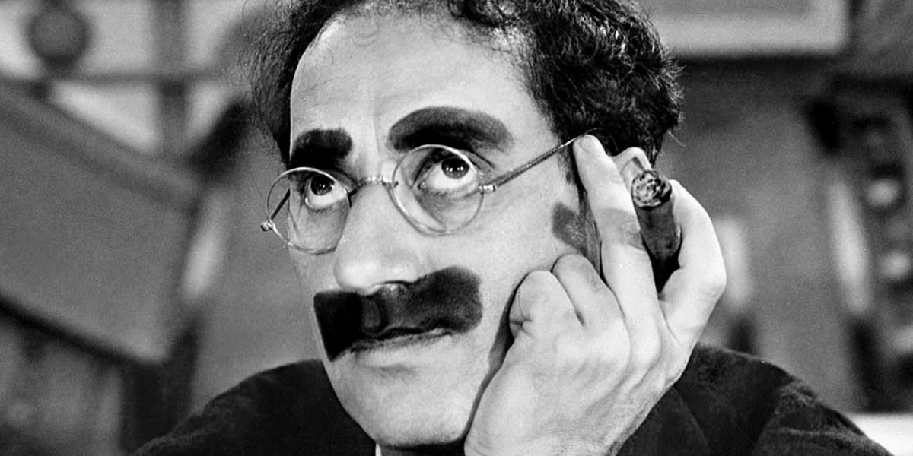
Fruit Flies like a Banana

Slide 33
“To understand a program you must become both the machine and the program”
- Alan Perlis

Slide 34
So can we…
Use constrained language
…without the human “cheating”?
Give clear instructions
…to achieve our goal?
Notes:
The constant struggle or balancing act is to make it easy for you to say what you want while trying to be precise enough for a computer to follow and make sense of.
We will come back to this idea again and again.

Slide 35

Train?

Slide 36
Direct a Tourist
You are approached by a foreign tourist in Newcastle city centre, just outside of the Haymarket metro station. They only understand a few words of english but need to catch a train from the Central Station.
Write down instructions to help them get from their current location to their desired destination.
They understand walk, turn left, turn right and distances (and maybe some others).
Improvised street names are allowed.

Slide 37
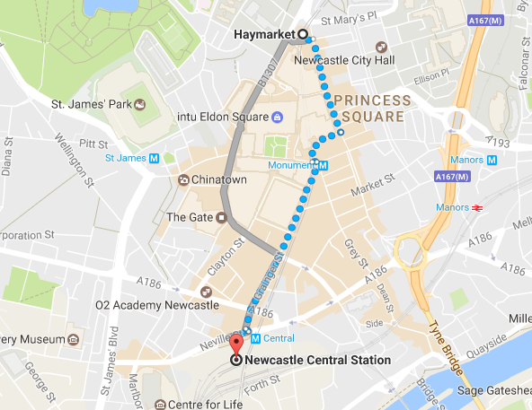

Slide 38
Answers?

Slide 39
Bonus
How would you change your answer if the person was blind?

Slide 40
Why do you care
so much
about language?
Notes:
going to be picking on language a lot today. Imagine if you are reading the menu in a restaurant. Chef wants you to think of…

Slide 41
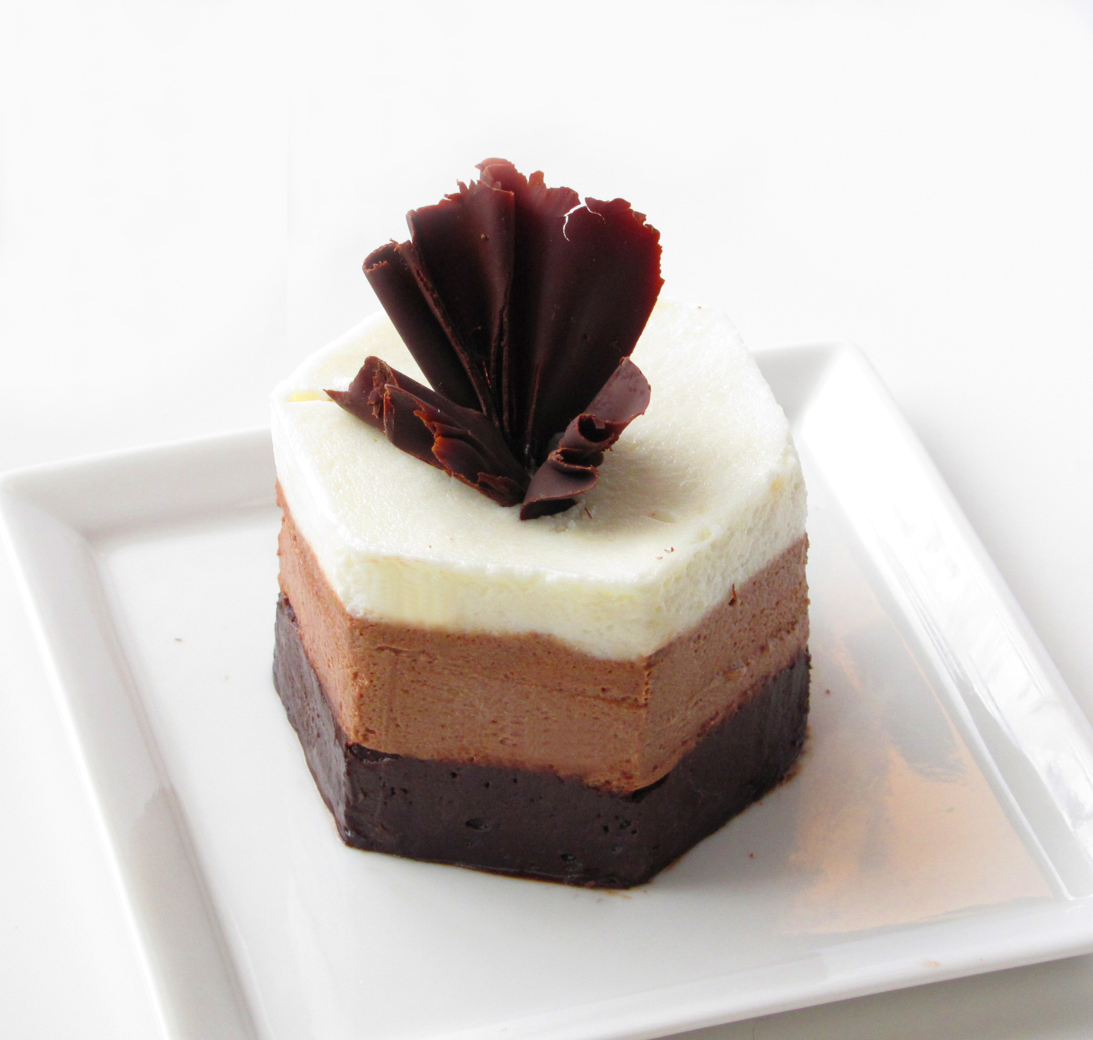
Notes:
this, but because of a single letter mistake, you think this is on the menu.

Slide 42
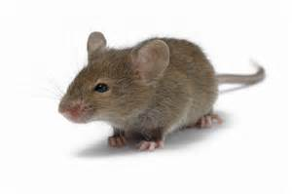
Notes:
computer can’t tell the difference, will give you what you asked for not what you intended

Slide 43
If you ask for a mouse…

Slide 44
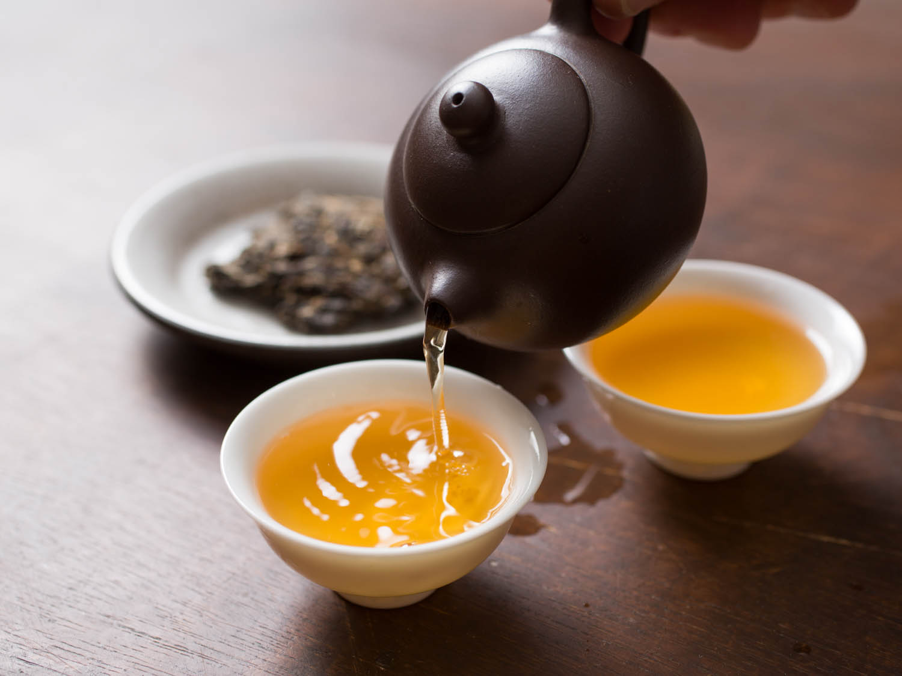
Tea?
Notes:
so now i’ve got you all thinking about food…

Slide 45
Make a Cup of Tea
Your new Robot Butler understands lots of verbs and nouns but does not know how to make you a cup of tea the way you like it. Write down commands that he can understand and follow to make a cup of tea.
Here are the words your butler understands:
spoon cup water kettle pour
stir fill clean sugar close
milk teabag coffee saucer switch-on
raise fridge lower empty open
switch-off take cupboard full if
when before after while wait

Slide 46
Answers?

Slide 47
Bonus
How would you change the instructions if you wanted your butler to be able to make tea for a visitor to your home?

Slide 48
“Within a computer natural language is unnatural”

Slide 49
Levels of Understanding
Simple Commands
Require close attention to detail
Lots of control
Complex Commands
Easier to reason about
Less fine-grained control
Notes:
Opportunities for Role play
Different robots understand different instructions. Some are mathematical, some are more general, some know about tea and milk, others can do the same job but need to be told exactly where to go exact positions, exact commands. High level vs low level languages.

Slide 50

Phone

Slide 51
The Dog and Bone
The new NLP (natural language processing) implant you ordered from Amazon for the family pet has arrived, just in time for your first day ill in bed with the flu. You are so ill that your pet needs to call in sick for you. Write down the instructions they could follow to use a telephone to call your work, pass on the message then hang up.

Slide 52
Answers?

Slide 53
Clarity
How would you explain it if you weren’t going to be around?
What if you were leaving the most literal minded person in charge?
How comfortable would you feel ?
How could they misinterpret ?
Can you account for all those eventualities?
Notes:
Debugging and Thinking ahead about consequences. Does making account of all cases make your solution too unwieldy?

Slide 54
Programming is…
Doing the right things
In the right order
Before, after or at the same time as other things
For the right number of repetitions
In the right circumstances…
…with limited resources
Notes:
Programming time, execution time, memory, etc.
Encryption and the heat death of the universe.

Slide 55
Algorithms
we’ve been talking about them!
a list of unambiguous instructions
what makes a good algorithm?
what is the problem?
what are the constraints?
Notes:
What makes a good algorithm. If you are making lunch for yourself, how long it takes could be your only requirement. You might be hungry. If you are a chef trying to feed 1000 people at a banquet and have to coordinate 100 kitchen staff, efficiency and speed might not be the consideration you choose. What if
everyone is wanting the butter or a knife at the same time? Does everyone need their own fridge.
Depending on what you want to achieve, your algorithm might work but take a lot longer or it might not work at all.
Does you algorithm have to change when faced by with the real world. How does it match up. Are there big changes or small changes.

Slide 56
Models

Slide 57
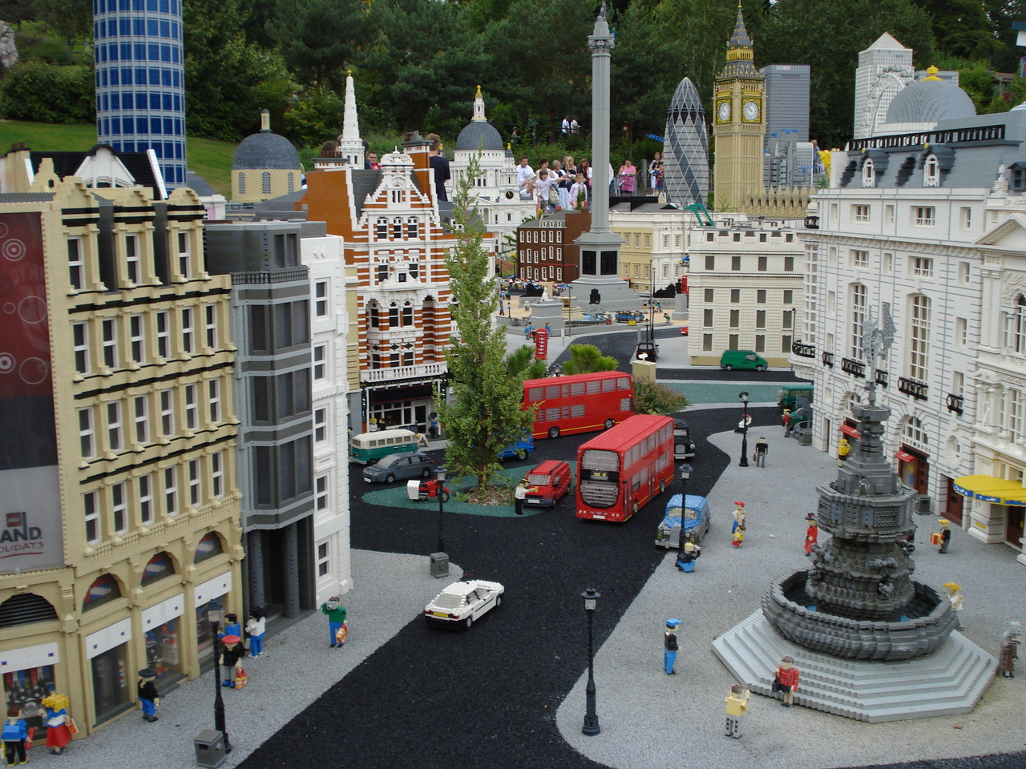
Notes:
modest representation of London skyline. No plumbing or wiring, no sewers

Slide 58
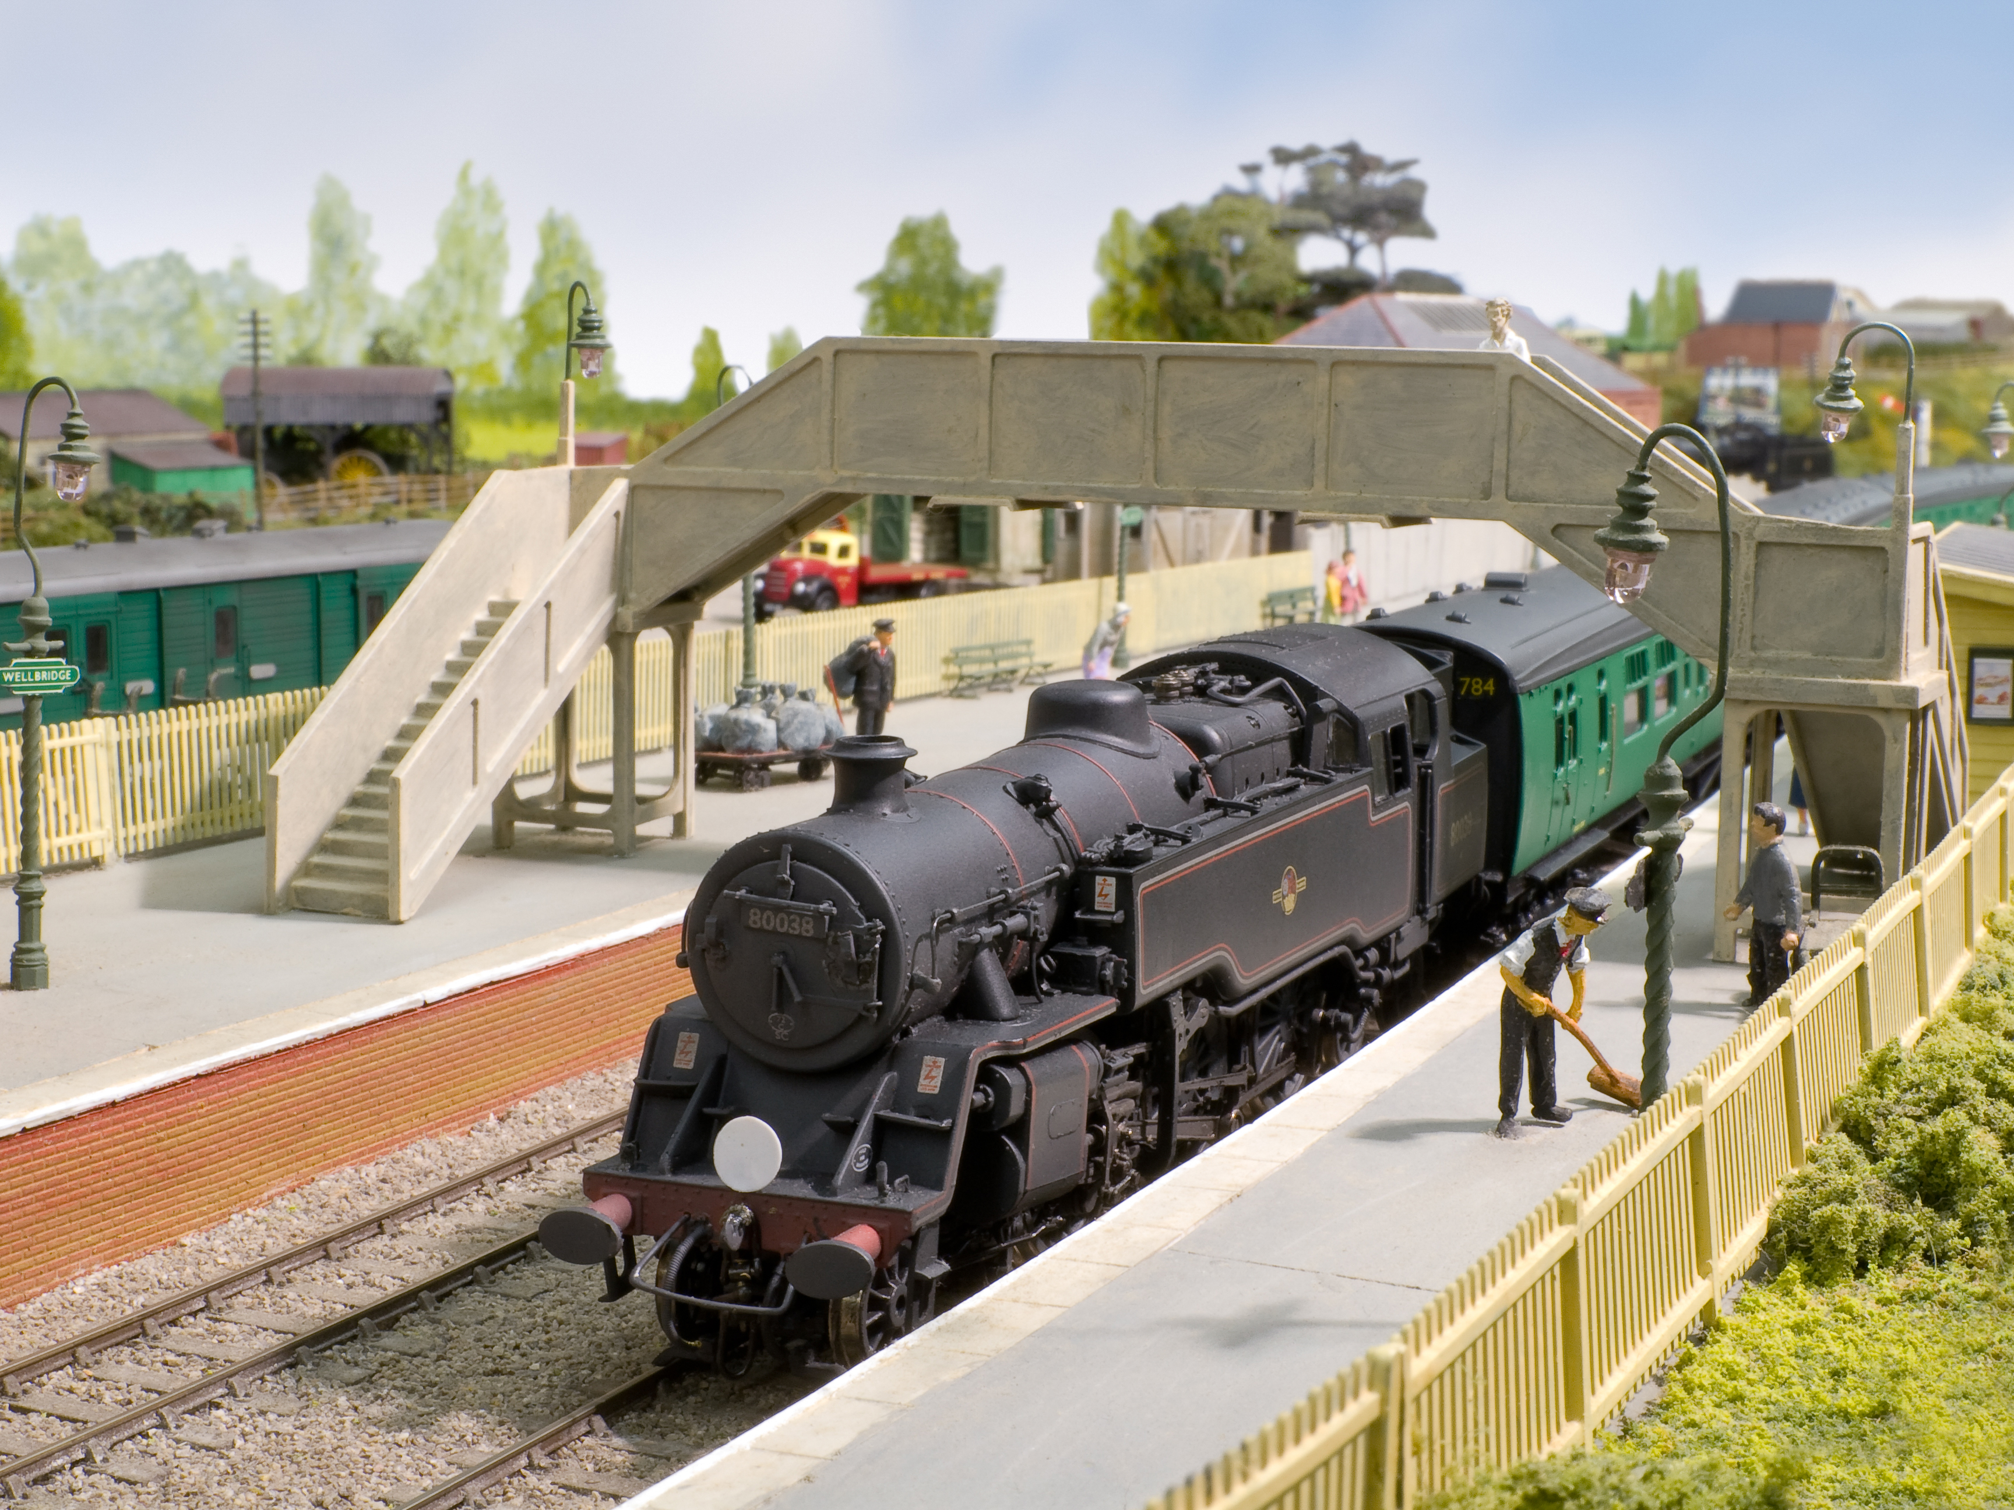
Notes:
Lets you experience what it’s like to drive a train or plan a railway. No one has to pay the staff or read the station master’s children a bed time story.

Slide 59
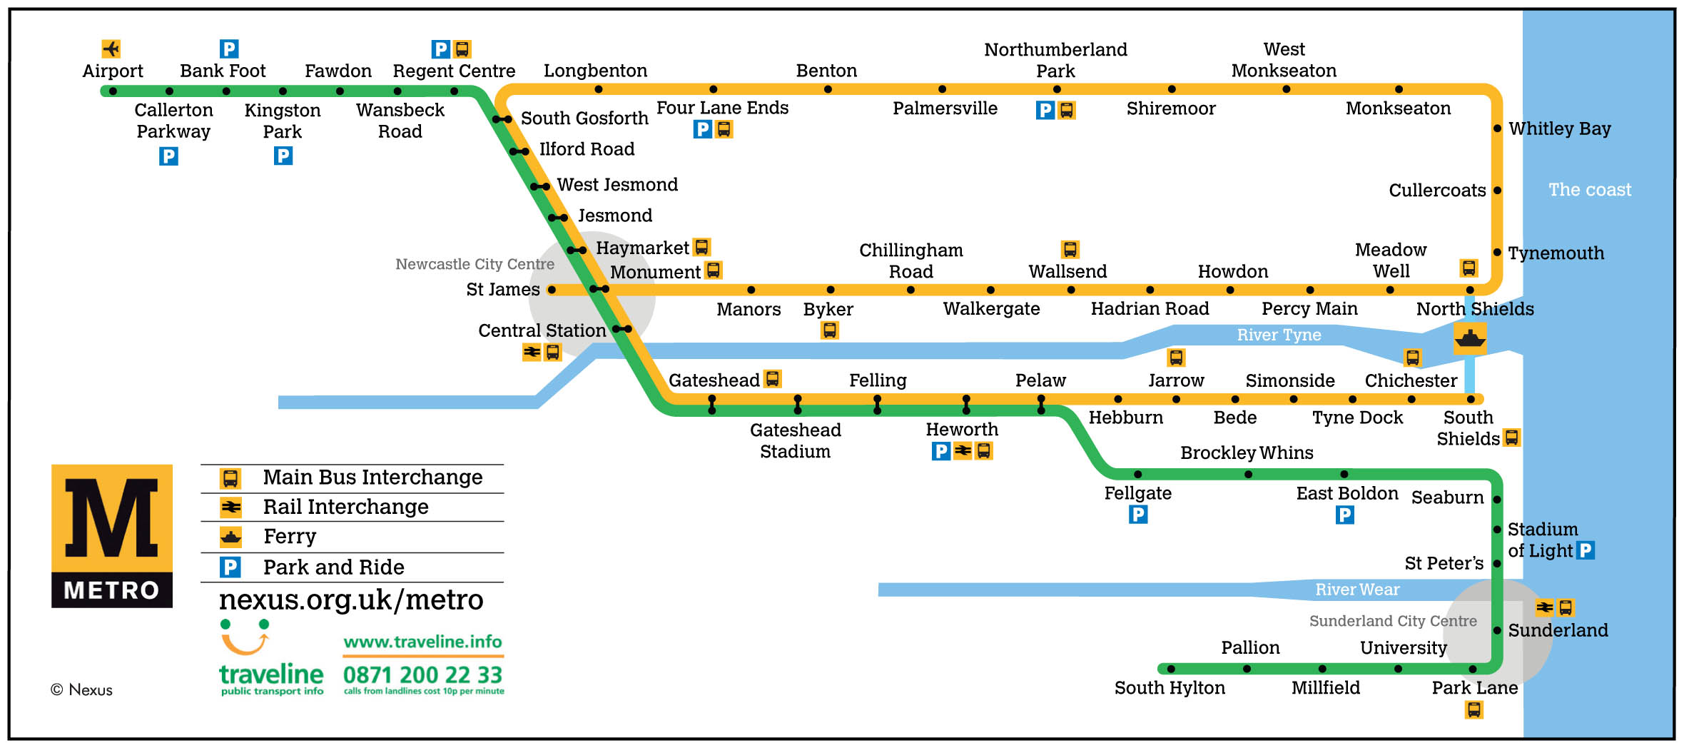
Notes:
Useful to know which way to travel one station to another.
Not good for navigation on foot.

Slide 60

Notes:
All models are flawed but some are useful.

Slide 61
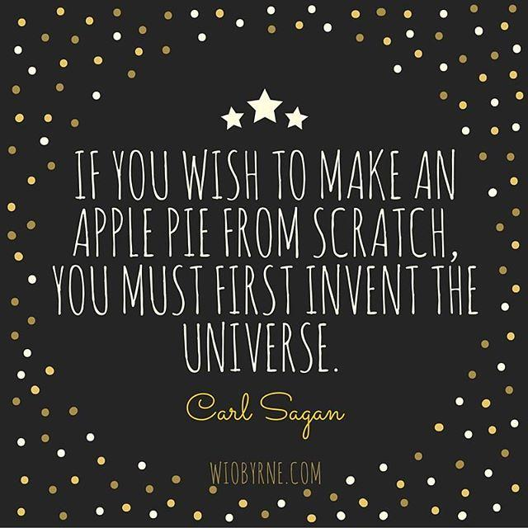
Notes:
help to understand and solve a problem, we don’t need to model all of reality.

Slide 62
Abstraction
Notes:
All these examples are types of abstraction used for solving single or small number of problems - not all the problems.

Slide 63
Problem Solving Strategies
& Tactics
Notes:
Later on when you are writing a program, it can be helpful to adopt these strategies to debug a program that doesn't do what you want. Or mostly does what you want but sometimes goes wrong.

Slide 64
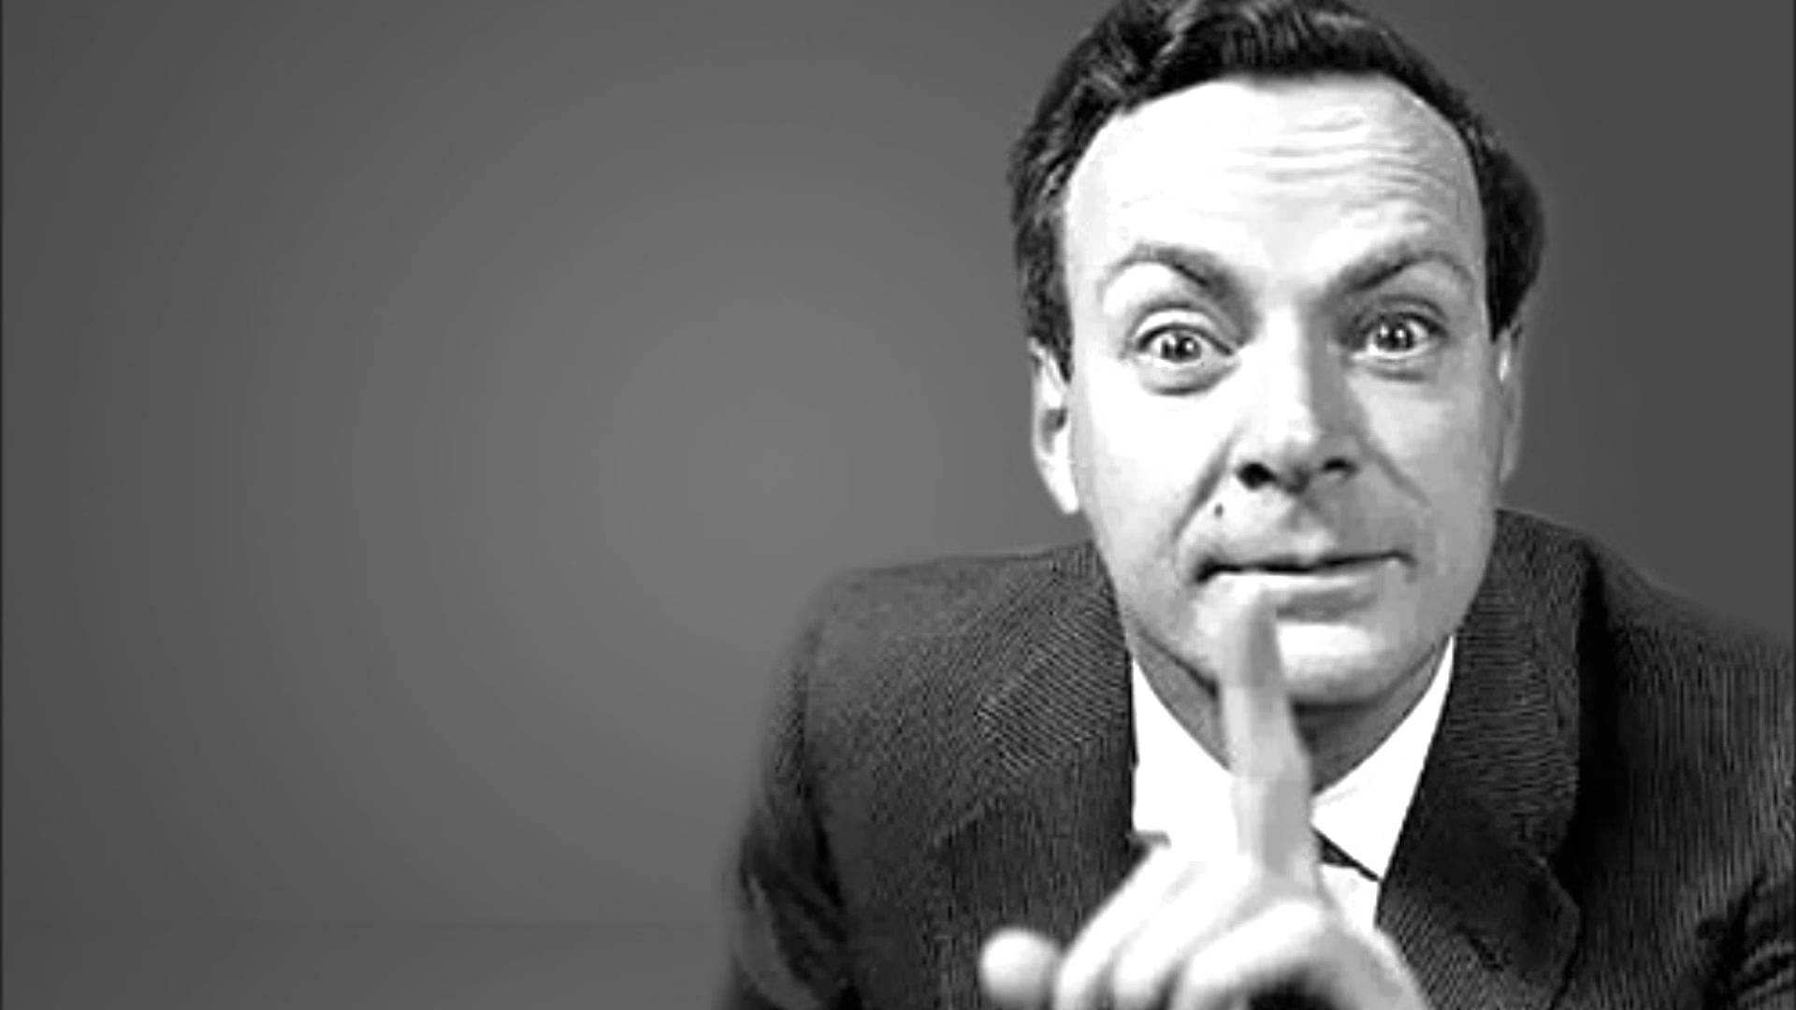
The Feynman Method
Write down the problem.
Think very hard.
Write down the answer.

Slide 65
Pencil and Paper
What steps are involved?
Do I have enough information?
Do I have too much information?
Have I made it as simple as possible?
What happens if…?

Slide 66
Roleplay
Pairing
Collaboration
Acting out the steps
Critically examining the code
Notes:
Opportunities for Role play
Different robots understand different instructions. Some are mathematical, some are more general, some know about tea and milk, others can do the same job but need to be told exactly where to go exact positions, exact commands.
What issues might you face when trying to program each one of these? High vs Low.
High level vs low level languages.

Slide 67

Notes:
Rubber Ducking - explaining the problem and what might be the cause of it.

Slide 68
What have we learned?
Breaking down a problem into steps
Validating our approach
Sequences
Variables
Iteration
Abstraction
Notes:
Now we've got some mad programming skillz, lets move on to using a programming language on some actual computers.

Slide 69
Programming is AWESOME.
Discuss.

